Slide 1


Automatic Segmentation of Cardiac MRI
3 September 2023

Slide 2
Meet the Team
Nabilah Hannani Dataset Preparation, and Segmentation Experiments Code | Daniel Riandy Datasets Preparation
Louis J. Zhang Segmentation and Deployment Code | Bayu Dwi Prasetya Deploymeny
Mas Aly Afandi Data Analysis and Improvement | Muhammad Yogi Datasets Preparation
Bayu Andrianto Wirawan Background Analysis | Asrul Said Model Experiment
Edward Sze Datasets Preparation | Irsyad Dzulfikar W.P. Model Exploration
Syaiful Hasibuan Model Exploration

Slide 3

Background & Problem Statement
Cardiac cine Magnetic Resonance Imaging (MRI) is primarily used for assessment of cardiac function and diagnosis of Cardiovascular disease (CVDs).
Globally, cardiovascular diseases with high mortality rates are causing significant risk and burden to healthcare systems.
By delineating the left ventricular cavity, right ventricle, and myocardium from cardiac magnetic resonance images (multi-slice 2D cine MRI), diagnosis can be made.
Cardiac MRI is considered the most accurate method for the estimation of clinical parameters such as ejection fraction, ventricular volumes, stroke volume, and myocardial mass.
Segmentation boundaries can be manually marked, but that is likely to be error-prone and time-consuming. As a result, we need automatic segmentation and diagnosis techniques after the MRI image is out without manual intervention.

Slide 4
Objectives & Scope
Segmentation
Goal : accurate segmentation which label the pixels corresponding to the myocardium, left ventricle, and right ventricle automatically.
Metric: average dice coefficient for right ventricle, left ventricle, and myocardium for end diastole and end systole (6 scores)

Slide 5
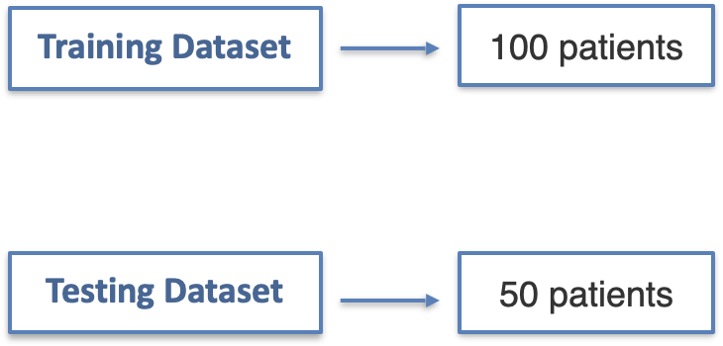
Data Collection & Preparation
Claim: “Automatic Cardiac Diagnosis Challenge” dataset (ACDC) is largest publicly-available and fully-annotated dataset for the purpose of Cardiac MRI (CMR) assessment.
Total: 150 patients with 3D cine-MR datasets with reference measurements and classification from two medical experts.
Including: manual expert segmentation of the right ventricle (RV) and left ventricle (LV) cavities, and the myocardium.

Slide 6
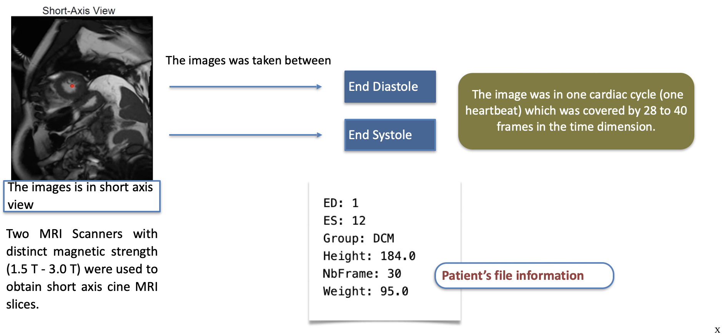
Data Collection & Preparation

Slide 7
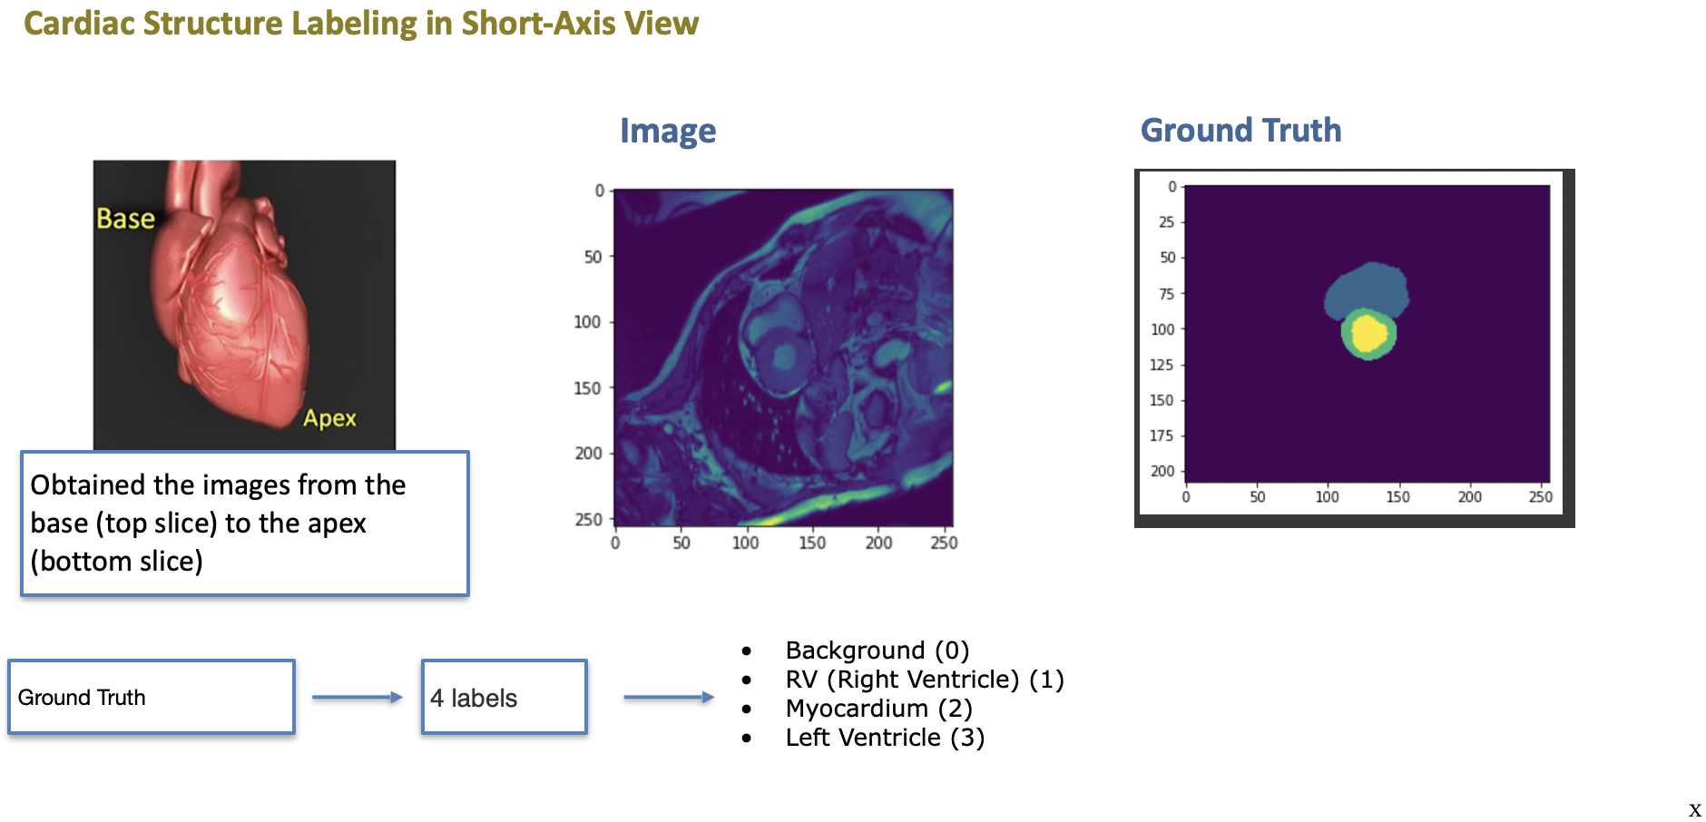
Data Collection & Preparation

Slide 8
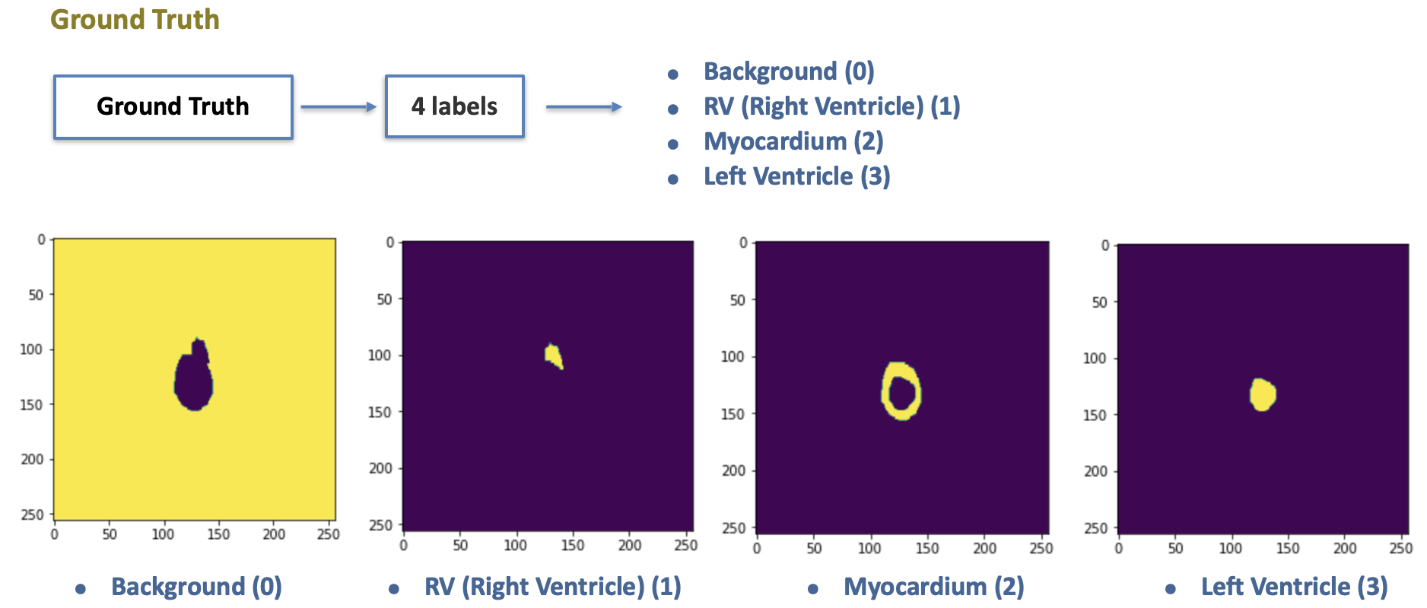
Data Collection & Preparation

Slide 9
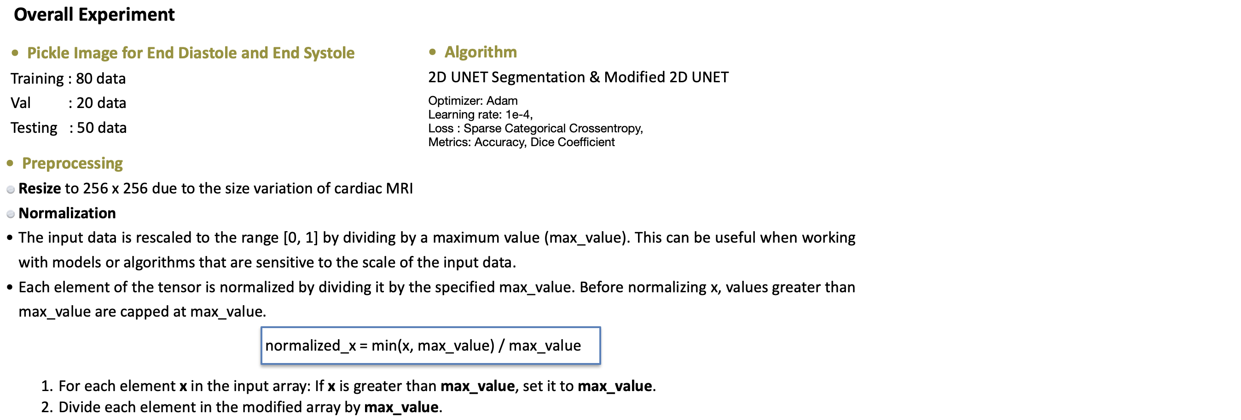
Model Development

Slide 10
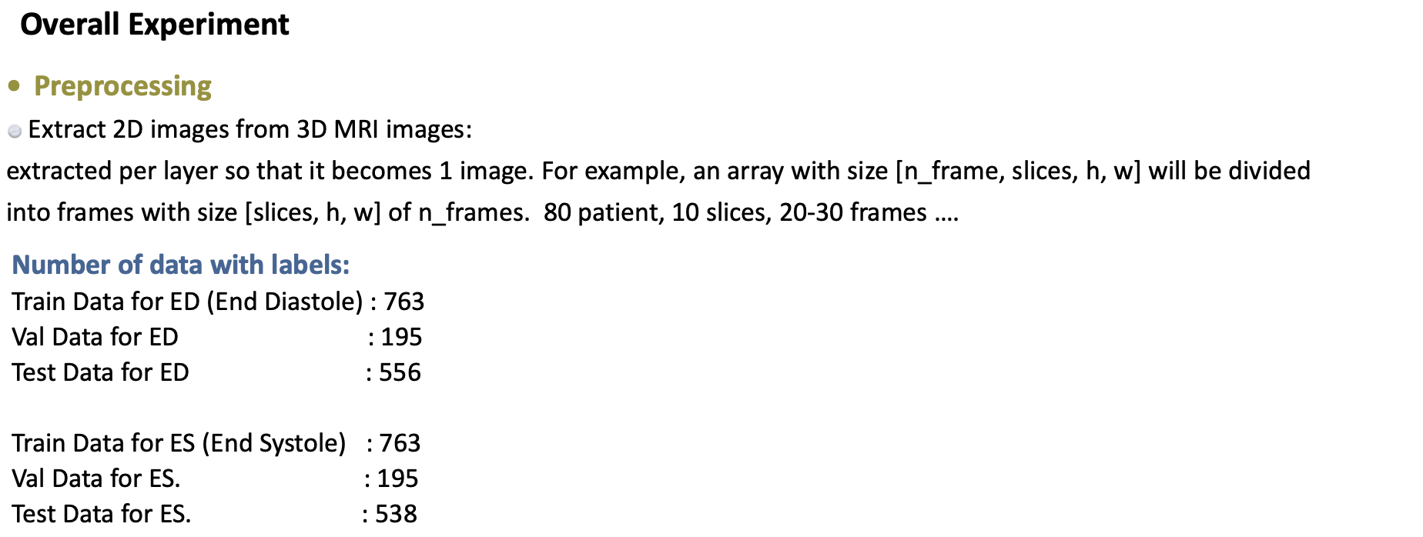
Model Development

Slide 11
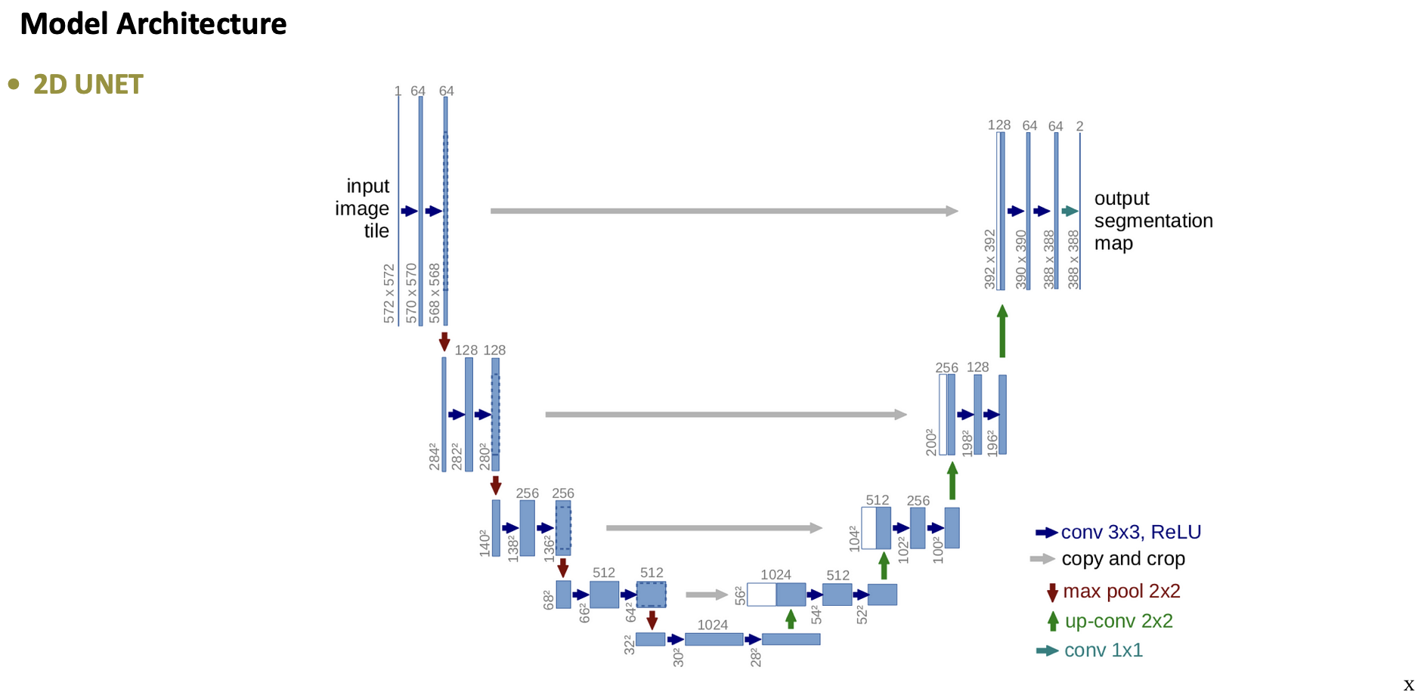
Model Development

Slide 12
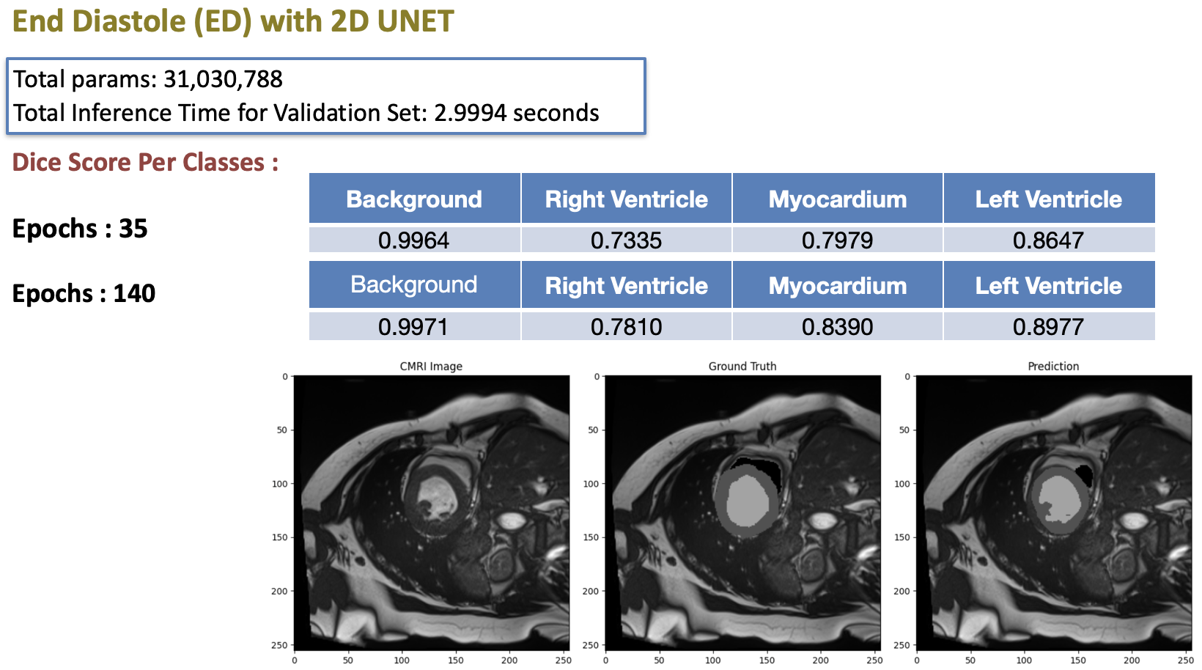
Results

Slide 13
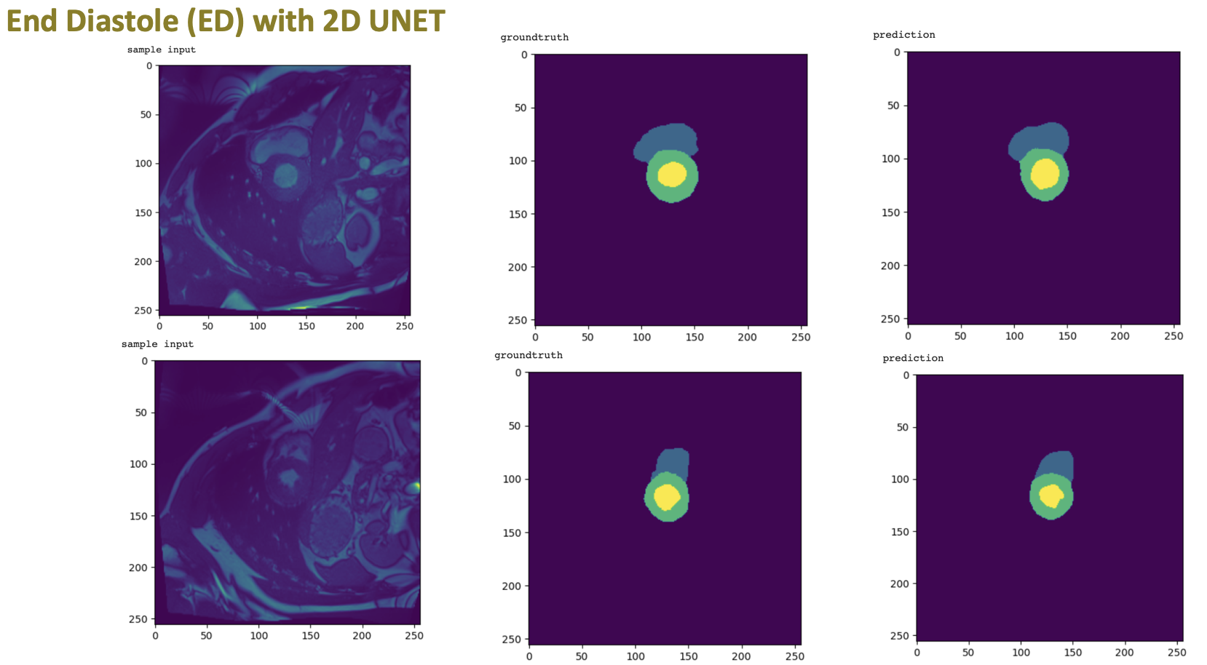
Results

Slide 14
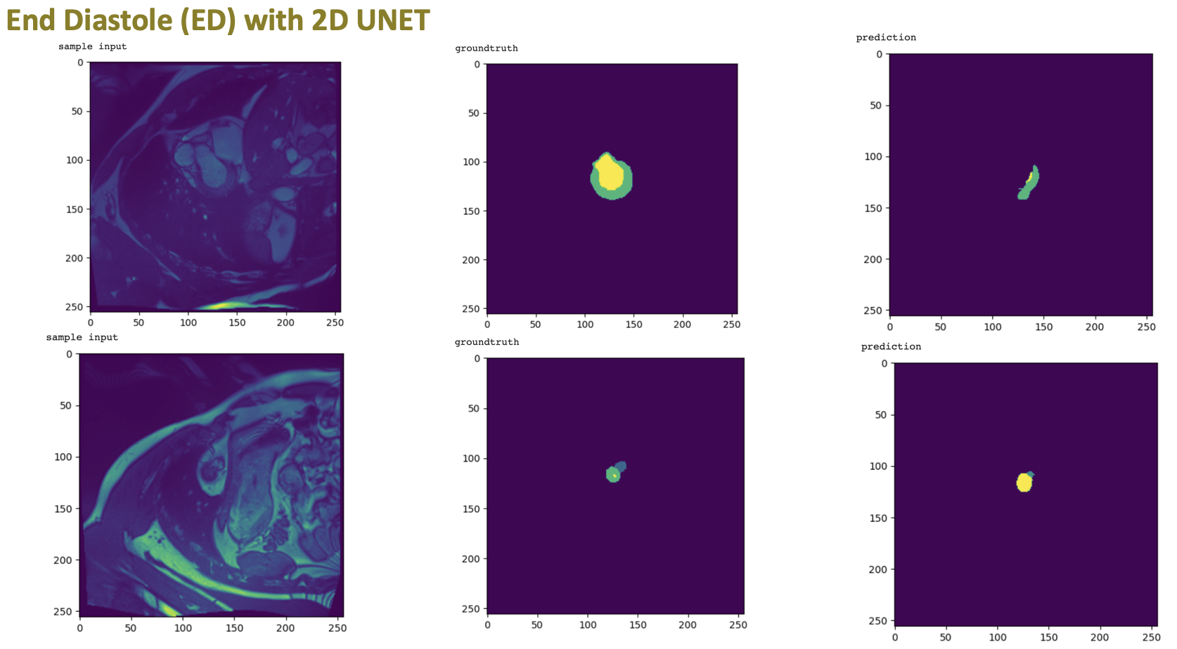
Results

Slide 15

Real-world Application
Hosted using Fast-API Docker in Google Cloud Platform

Slide 16

Conclusion
As diagnosing time is critical in medical task, the increase of processing speed will help the healthcare system.
The most difficult part to segment in Cardiac MRI is right ventricle. Meanwhile, the easiest one is left ventricle.
UNET with standard preprocessing (resize and normalization) produce quite well result for some images but they need more improvements to increase the accuracy.

